Slide 1
Best Practices for Data Scientists
Workshop Outline
Dr. Péter Molnár
June 25, 2021

Slide 2

Dr. Péter Molnár is a data scientist for Machine Learning and Artificial Intelligence at Amazon Web Services (AWS). Dr. Molnár is a member of the Institute for Insight at the Robinson College of Business at Georgia State University, where he supports students and faculty in research and instruction. His academic research in social agent systems, collaborative systems, and distributed sensor-fusion has received funding from federal and state agencies. He taught courses in artificial intelligence, machine learning, robotics, and computer vision on the graduate and undergraduate level. Dr. Molnár received his doctorate in theoretical physics from the University of Stuttgart, Germany and a master’s degree in physics from the Augusta Georgia University, Göttingen, Germany.

Slide 3
Topics
Coding Practices
Working with notebooks, create re-usable code
Source Code Versioning
Mange your code across local and remote systems and within your team
Documentation and Testing
Explain what your code does, make sure it does what it claims to do
Processing Tabular Data
Simplify code using mapping/reduce, declarative vs procedural
Data Management
Organize and manage data: data store, schema and naming conventions

Slide 4
Source Code Versioning
Best Practices for Data Scientists
Dr. Péter Molnár
June 25, 2021

Slide 5
Source Code Versioning
System to track code changes and ensure consistent source code across computers and users.
Tracks code lines that are different between versions → only works one text files, e.g. program code, configuration files
Not suitable for data files or binary files (images, PDF, DOCX, etc.)

Slide 6
Work Flow
Working on remote system
Copy between desktop and remote server
Ensure that changes are made properly
Local: edit file
Local: add/commit/push to git repo
Remote: pull
Remote run code
Working with team
Create new branch, just for personal use
Work on code, commit frequently, also use same branch to update on remote system
By end of sprint
commit final version of my code
submit “merge request”

Slide 7
Flow of Code Changes
Create personal branch at beginning of sprint
Submit merge request to main line at end of sprint
Frequently commit to personal branch during sprint
Upload code file to repo in initial commit
Make changes to file and commit new versions
Bob creates a branch, and works on a (private) copy
Once the work is completed, Bob commits to branch and makes a merge request
Ann and Cloe review merge request and either
Approve if there are no conflicts: main line is updated with Bob’s changes
Reject: Bob needs to align with main line to resolve any conflicts
Merge with conflicts: include Bob’s changes, but some files may have to be fixed manually
Initial commit
Second commit
Third commit
Bob gets a copy
Fourth commit
Bob’s commit
Merge

Slide 8

GIT https://git-scm.com
GIT (created by Linus Torwalds) seems to be the most popular version control system these days.
There are several open source and commercial applications that support GIT.

Slide 9
Command Line Interface
The GIT command line interface works the same on all platforms: Linux, mac OS, Windows.
The format is:
$ git [COMMAND] [OPTIONS]
Examples:
$ git add myprog1.py myprog2.py
$ git status
While the git CLI can do everything users may take advantage of (web-based) user interfaces or Integrated Development Environments (IDEs)

Slide 10
Common GIT commands
command | description
git clone url [dir] | copy a Git repository so you can add to it
git add file | adds file contents to the staging area
git commit | records a snapshot of the staging area
git status | view the status of your files in the working directory and staging area
git diff | shows diff of what is staged and what is modified but unstaged
git help [command] | get help info about a particular command
git pull | fetch from a remote repo and try to merge into the current branch
git push | push your new branches and data to a remote repository
others: init, reset, branch, checkout, merge, log, tag

Slide 11
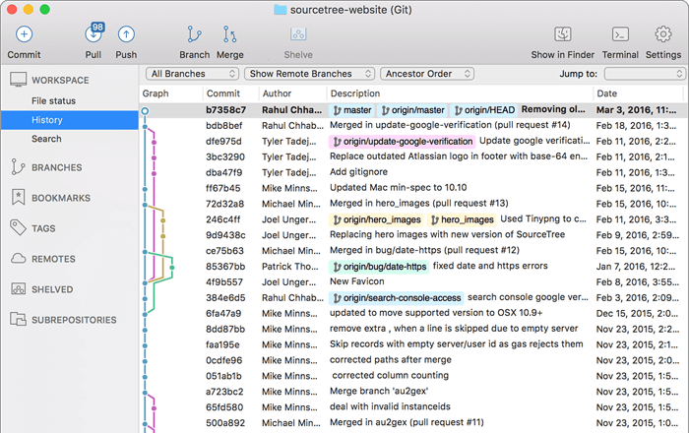
Sourcetree (Atlassian)
https://www.atlassian.com/software/sourcetree

Slide 12
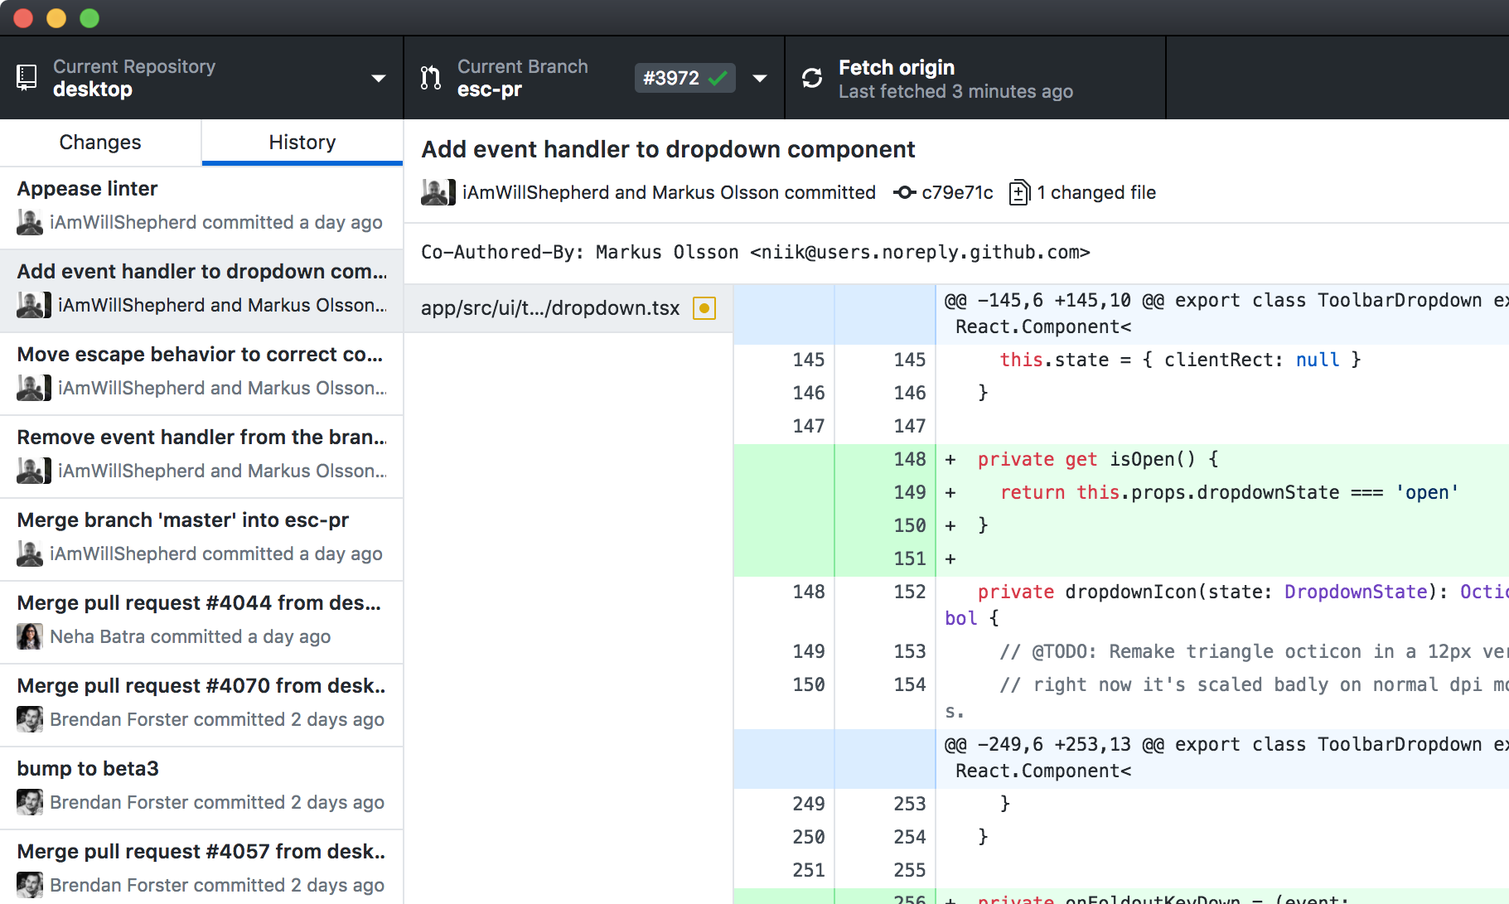

GitHub Desktop https://desktop.github.com

Slide 13
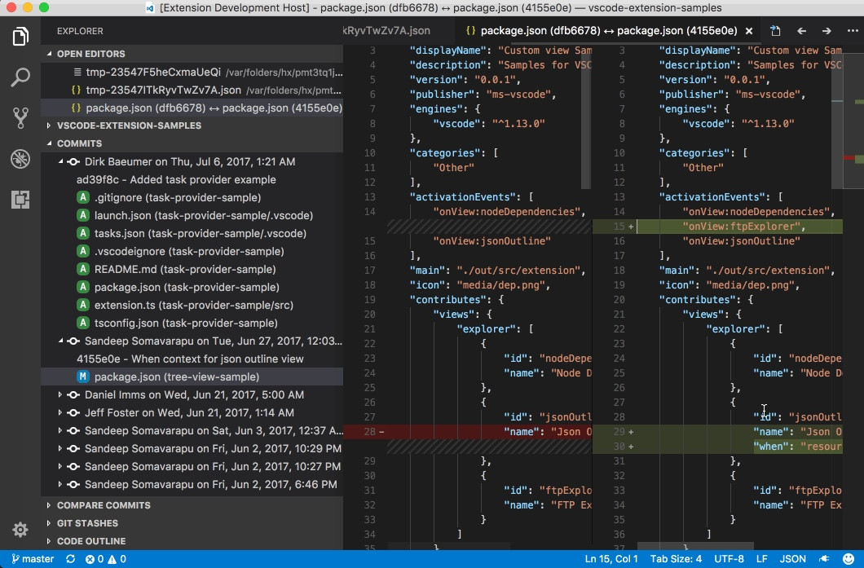
Visual Studio Code (Microsoft)

Slide 14
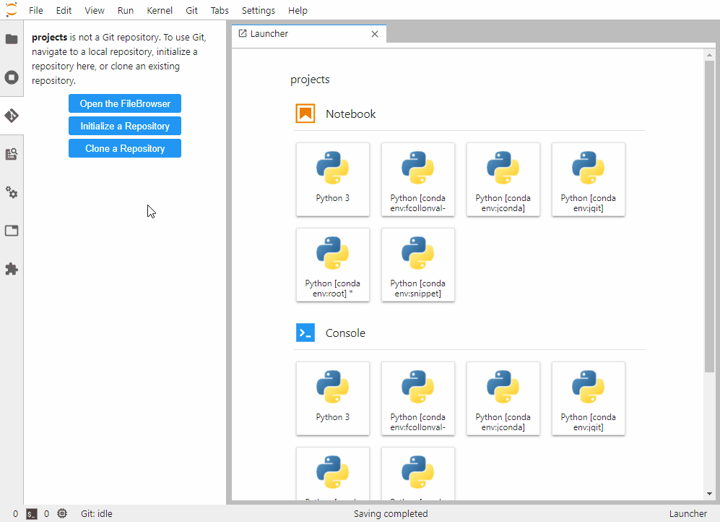
Jupyter Lab GIT Extension
https://github.com/jupyterlab/jupyterlab-git

Slide 15
GIT Hosting Options
GitHub https://github.com
Cloud based commercial service
GitLab https://gitlab.com or https://gitlab.com/gitlab-org/gitlab-foss
Cloud based commercial service or self-hosted (free/commercial)
Atlassian BitBucket https://bitbucket.org/product/
Commercial cloud based (free for < 5 users) and self hosted
AWS CodeCommit https://aws.amazon.com/codecommit/
Commercial cloud based
Several open source projects
https://www.cyberciti.biz/open-source/github-alternatives-open-source-seflt-hosted/

Slide 16
SSH configuration
Usually, git servers work with SSH key pairs
Create SSH key on local computer
Upload public key to git server. Most systems offer a web interface where users can add public SSH keys to their user profile.
Companies may employ more sophisticated authentication methods.

Slide 17

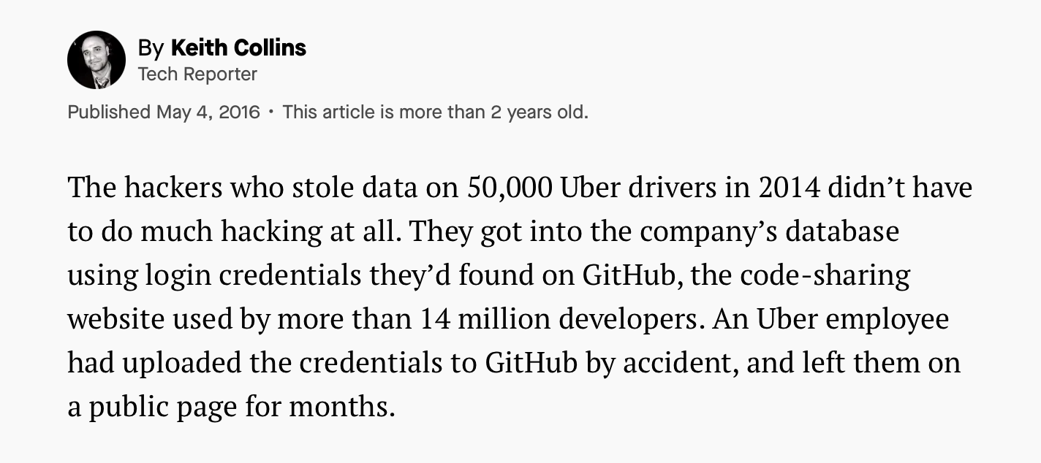
DANGER!
Don’t commit access credentials to the git repo!
Use local JSON file with access credentials to data bases or cloud services
Prevent local file from committing to repo:
store local file outside of git project folder
list file name in .gitignore

Slide 18
Resources
Detailed lecture presentation https://www.cis.upenn.edu/~matuszek/cit591-2012/Lectures/git.ppt
Introduction to Git for Data Science https://towardsdatascience.com/introduction-to-git-for-data-science-ca5ffd1cebbe
A Guide to Git for Data Scientists https://towardsdatascience.com/a-guide-to-git-for-data-scientists-fd68bc1c729

Slide 19
Documentation and Testing
Best Practices for Data Scientists
Dr. Péter Molnár
June 25, 2021

Slide 20
Documentation and Testing
Make code understandable with sufficient documentation and testing
Verify integrity of the code during development
Run-time test for data and model may look similar…though need to be handled separately
Documentation
Comments: Anywhere in the code (line, block)
Docstrings: Multi-line string for functions and classes
Brief description of purpose and requirements or limitations
Input parameters
Return values
Testing
Run parts of the code (on sample data)
Verify that the code produces the expected output and doesn’t break
Perform manually: run in notebook, review output files and screen shots, keep records
Automated testing:

Slide 21
Style and Documentation
Generally style is built into Python, as it demands indents.
However, good Python style is set out in PEP8:
https://www.python.org/dev/peps/pep-0008/
Use 4 spaces per indent, rather than tabs.
Use blank lines before function definitions, and to separate logical code units.
function_names; variable_names; keyword_named_variables_; ClassNames; modname; CONSTANT_NAMES
Keep lines to 79 characters or less.
Spaces around operators and after commas, but not just inside (){}[]: a = (1, 2)
Indent comments to the level of the code referred to.
Agree on naming conventions within your team or organization
Consider application across all platforms and programming languages
Notes:
Note that it is bad practice to call a variable the same as a keyword, but you can use a trailing underscore to distinguish if you must.

Slide 22
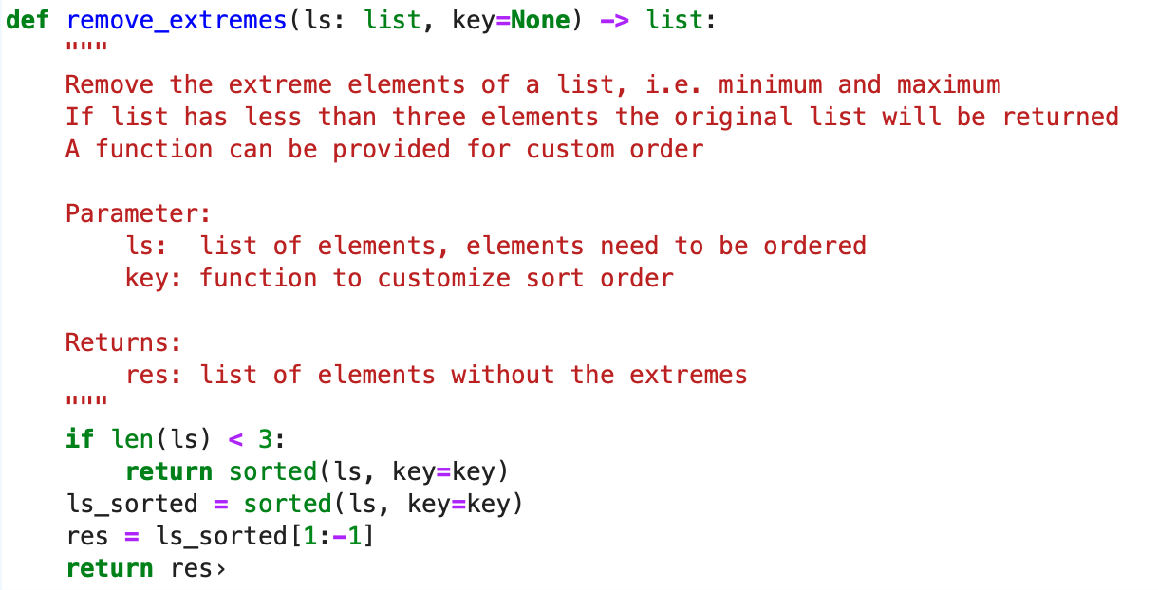
Example with Docstrings and Type Hints
Triple quotes after def statement
There are different styles for content
No formal syntax

Slide 23
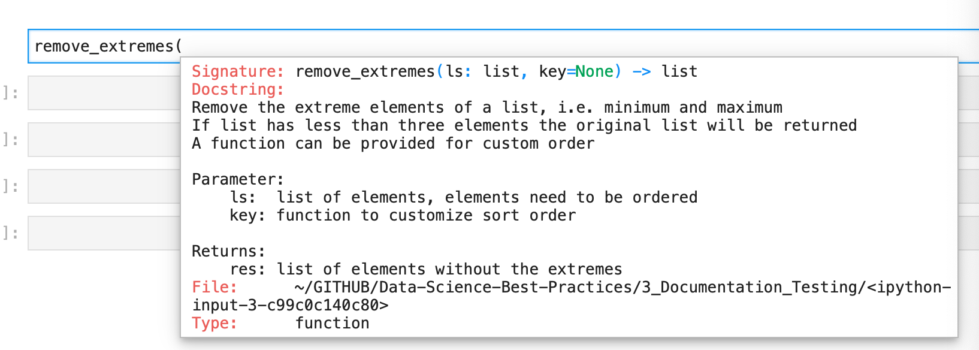
Doc String Support in Jupyter Notebooks
hit <Shift><Tab>

Slide 24
PyDoc Tool
PyDoc is the documentation system distributed with Python https://docs.python.org/3/library/pydoc.html
Use from the command line to
Show docstrings for a Python program/module $ pydoc functions $ pydoc functions.get_anchor_word_window_by_sent
Create an HTML document $ pydoc –w functions produces HTML file “functions.html”
Interactive Web-UI to browse documentation of modules in current folder and the packages they use $ pydoc –b opens default web browser for UI
Notes:
"""
Add two random numbers together
Requires no setup.
"""
import random
def add (num1, num2):
"""
Add two numbers.
Postional arguments:
num1 -- an integer or double number (no default)
num2 -- an integer or double number (no default)
Returns:
The sum of the numbers.
"""
return num1 + num2
numA = random.random() * 10
numB = random.random() * 10
print(add(numA, numB))
# Download this file
# Run it with
# python -i docs.py
# This will run the file and leave you at the command prompt, with the file imported.
# Now try
# help(add)

Slide 25
Other software
There is a starter list of alternative software at:
https://wiki.python.org/moin/DocumentationTools
A popular one is Sphinx, which comes with Anaconda:
http://www.sphinx-doc.org/en/stable/
http://www.sphinx-doc.org/en/stable/tutorial.html
http://www.sphinx-doc.org/en/stable/invocation.html#invocation-apidoc
Notes:
Make a docs directory, and copy docs.py into it.
Open a command prompt.
sphinx-quickstart
Root path for documentation[.]: <ENTER>
Separate source and build directories(y/n)[n]: <ENTER>
Name prefix for templates and static directories[_]: <ENTER>
Project name: docstest
Author: Your name
Project version: 1
Project release: <ENTER>
Project language [en]: <ENTER>
Source file suffix [.rst]
Name of your master document (without suffix)[index]: <ENTER>
Do you want to use the epub builder (y/n) [n]: <ENTER>
autodoc: automatically insert docstrings from modules (y/n) [n]: <ENTER>
doctest: automatically test code snippets in doctest blocks (y/n) [n]: <ENTER>
intersphinx: link between Sphinx documentation of different projects (y/n) [n]: <ENTER>
todo: write "todo" entries that can be shown or hidden on build (y/n) [n]: <ENTER>
coverage: checks for documentation coverage (y/n) [n]: <ENTER>
pngmath: include math, rendered as PNG images (y/n) [n]: <ENTER>
mathjax: include math, rendered in the browser by MathJax (y/n) [n]: <ENTER>
ifconfig: conditional inclusion of content based on config values (y/n) [n]: <ENTER>
viewcode: include links to the source code of documented Python objects (y/n) [n]: <ENTER>
Create Makefile? (y/n) [y]: <ENTER IF ON MAC>
Create Windows command file? (y/n) [y]: <ENTER IF ON WINDOWS>
Make a directory _source
Copy in docs.py
sphinx-apidoc -o _source _source
Copy index.rst into _source
sphinx-build -c . -b html _source _build

Slide 26
Testing

Slide 27
Code Testing
Unit
Integration
Regression
You should test that the program works the way a user/customer expects the application to work. Acceptance tests ensure that the functionality meets business requirements.
Acceptance
After integrating (and maybe fixing) you should run your unit tests again. This is regression testing to ensure that further changes have not broken any units that were already tested. You can run your unit tests again and again for regression testing
You test the integrations of many units together.
You test each individual piece of code.
Think each class or method.
You make sure your code works when put together, including dependencies, databases and libraries.
usually, automated
http://www.getlaura.com/testing-unit-vs-integration-vs-regression-vs-acceptance/

Slide 28
Unit Tests vs Regression Tests
UNIT TESTS
A unit test is a test written by a programmer to verify that a relatively small piece of code is doing what it is intended to do. They are narrow in scope, they should be easy to write and execute, and their effectiveness depends on what the programmer considers to be useful..
Unit tests shouldn’t have dependencies on outside systems. They test internal consistency as opposed to proving that they play nicely with some outside system.
REGRESSIONS TESTS
Regression tests are performed whenever anything has been changed in the system in order to check that no new bugs have been introduced.
This means you re-run your unit and intergration tests after all patches, upgrades, and bug fixes. Regression testing can be seen as a special case of combined unit test and integration test.
http://www.getlaura.com/testing-unit-vs-integration-vs-regression-vs-acceptance/

Slide 29
How to write (unit) tests
Free Style For manual testing and human validation of test results.
Notebooks or scripts that use code on sample data Use assert statement or conditional statements
Must use the same code base, i.e., Python file
Use %loadpy or import in notebooks
Doctest
Suitable for simple unit-tests for functions.
Include test case as part of docstrings in Python code.
Advantage: Test cases reside close to function definition.
Disadvantage: Limited to simple tests
unittest
Formal method to conduct unit tests.
Can be integrated with automated testing environments.
Requires writing separate code (TestCase classes)
Allows (more) complex test cases.
Advanced Tools
A number of tools to develop automated test script. Often part of the deployment pipeline
Packages:
py.test
Hypothesis
tox
Mock
https://docs.python-guide.org/writing/tests/

Slide 30
Test in Documentation
"""
Add two numbers together.
>>> add(1,2)
3
"""
def add (num1, num2):
return num1 + num2
def mult(num1, num2):
"""
Multiply two numbers.
Parameters:
num1 -- number
num2 -- number
Returns:
product of the numbers
>>> mult(4,7)
28
"""
return num1 * num2
$ python3.9 -m doctest -v arithmetic.py
Trying:
add(1,2)
Expecting:
3
ok
Trying:
mult(4,7)
Expecting:
28
ok
1 items had no tests:
arithmetic.add
2 items passed all tests:
1 tests in arithmetic
1 tests in arithmetic.mult
2 tests in 3 items.
2 passed and 0 failed.
Test passed.
https://docs.python.org/3/library/doctest.html

Slide 31
Test with unittest
# arithmetic.py
def add (num1, num2):
"""
Add two numbers together.
"""
return num1 + num2
def mult(num1, num2):
"""
Multiply two numbers.
Parameters:
num1 -- number
num2 -- number
Returns:
product of the numbers
"""
return num1 * num2
# tests.py
import unittest
import arithmetic
class TestDocs(unittest.TestCase):
def test_add(self):
self.assertEqual(docs.add(1,2), 3)
if __name__ == '__main__':
unittest.main()
$ python tests.py
$ python -m unittest -v tests.py
create separate test code
https://docs.python.org/3/library/unittest.html
https://docs.python.org/3/library/unittest.html#assert-methods

Slide 32

Test Driven Development
More applicable to software development – still we may consider these ideas for data science projects:
Write the tests first, and then write the software to match the tests.
Good for working in teams: if the code matches the test, it shouldn't matter how it does it.
All team code uploaded to a shared repository should be tested.
References:
https://docs.python-guide.org/writing/tests/
https://en.wikipedia.org/wiki/Test-driven_development
https://en.wikipedia.org/wiki/Continuous_integration

Slide 33
Working with Tabular Data
Best Practices for Data Scientists
Dr. Péter Molnár
June 25, 2021

Slide 34
Working with Tabular “Structured” Data
Python Pandas
Open source, BSD-licensed library providing high-performance, easy-to-use data structures and data analysis tools for the Python programming language
Data structure for representation of tables and series (columns)
In memory: all data is loaded in the computer memory, table structure and table entries can be changed
SQL
The Structured Query Language (SQL) appeared around 1974 to be used with Relational Database Management Systems (RBDMS)
Apache Spark
Apache Spark achieves high performance for both batch and streaming data
Lazy evaluation: operations are only executed when required, define transformations for all records, evaluate when needed
Combine external distributed storage and in-memory processing

Slide 35
Pandas
Open source, BSD-licensed library providing high-performance, easy-to-use data structures and data analysis tools for the Python programming language
Data structure for representation of tables and series (columns)
In memory: all data is loaded in the computer memory, table structure and table entries can be changed
Benefits:
Fast processing
Limits:
Size of data is limited by computer memory
https://pandas.pydata.org/docs/

Slide 36
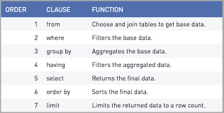
SQL
5) SELECT CONCAT(country, site) AS location,
DATEPART(YEAR, sales_date) AS yr,
SUM(sales_qty) AS total_sales
1) FROM company_sales
2) WHERE sales_status = ’completed’
3) GROUP BY CONCAT(country, site), DATEPART(YEAR, sales_date)
4) HAVING COUNT(total_sales) >= 10
6) ORDER BY total_sales
7) LIMIT 100
Assign as much workload as possible to the SQL server…

Slide 37
Apache Spark
Apache Spark achieves high performance for both batch and streaming data, using a state-of-the-art DAG scheduler, a query optimizer, and a physical execution engine
Data structure for representation of tables and rows
Lazy evaluation: operations are only executed when required, define transformations for all records, evaluate when needed
Combine external distributed storage and in-memory processing
Benefits:
Runs locally and on large cluster, same code to scale up
Parallel processing, fast and scalable
Challenges:
Additional step for software installation required
https://spark.apache.org/docs/latest/

Slide 38
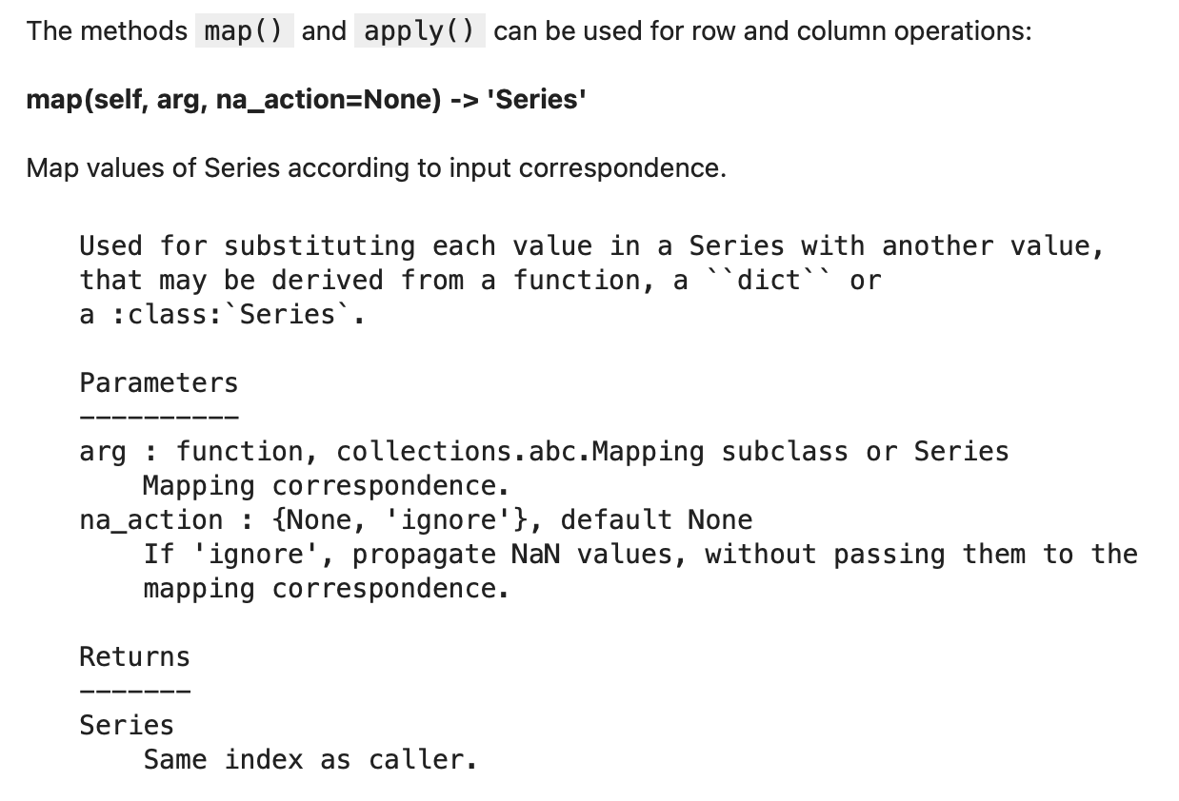
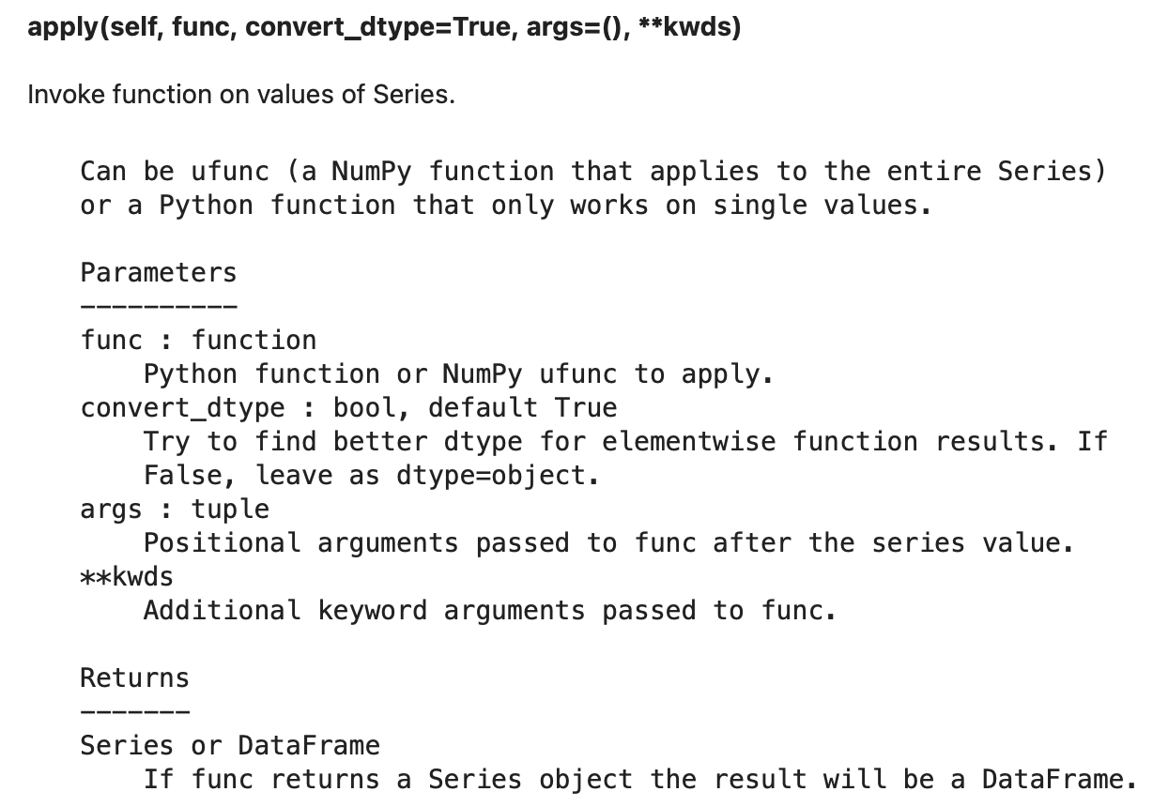
Pandas map() and apply()

Slide 39
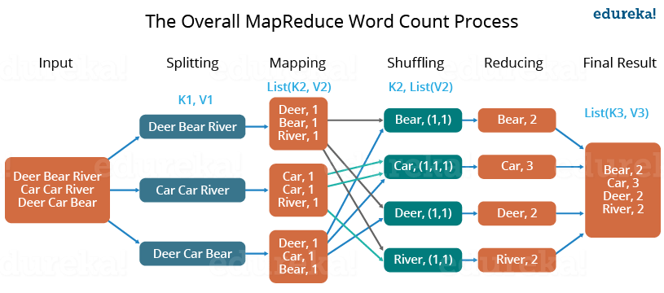
Map-Reduce & Group By

Slide 40
Word Count Example
Python Pandas
from functools import reduce
pdf = pd.read_csv('three_by_three.csv')
pdf2 = pd.DataFrame({
'word': reduce(
lambda a, b: a + b,
pdf.text.str.split()
)
})
pdf2['n'] = 1
pdf2.groupby('word').agg({'n': 'sum'})
SQL
SELECT word, count(1) AS n
FROM (
SELECT explode(split(text, ' ')) AS word
FROM threebythree
)
GROUP BY word
Apache Spark
df.select(
F.explode(
F.split('text', r'\s’)
).alias('word')) \
.groupBy('word').agg(
F.count('word').alias('n’)
) \
.show()

Slide 41
Joining Tables: SQL
Query classic and vintage car sales that were sold by US sales reps?
Employees with job title "Sales Rep" who are assigned to an office in the US and are the sales rep for customers of vintage and classic cars.
Using Common Table Expressions (CTEs) to structure the statements.
Select only required fields to avoid duplicates.
WITH us_sales_reps AS (
SELECT employeeNumber, lastName,
firstName, city, postalCode
FROM employees e
JOIN offices o
ON e.officeCode = o.officeCode
WHERE e.jobTitle = 'Sales Rep’ AND o.country = 'USA’
),
car_orders AS (
SELECT prod.productCode, prod.buyPrice,
prod.MSRP, det.priceEach, det.quantityOrdered,
or.customerNumber, or.shippedDate
FROM orders or
JOIN orderdetails det ON or.orderNumber = det.orderNumber
JOIN products prod ON det.productCode = prod.productCode
WHERE prod.productLine in ('Classic Cars', 'Vintage Cars’) AND or.status = 'Shipped'
)
SELECT sr.*, car.*
FROM car_orders car
JOIN customers cst ON car.customerNumber = cst.customerNumber
JOIN us_sales_reps sr
ON cst.salesRepEmployeeNumber = sr.employeeNumber

Slide 42
Joining Tables: Pandas
Query classic and vintage car sales that were sold by US sales reps?
Employees with job title "Sales Rep" who are assigned to an office in the US and are the sales rep for customers of vintage and classic cars.
Filtering cannot be chained to the same expression. Require multiple assignments.
Select only required fields to avoid duplicates.
df1 = pd.merge(employees_pdf, offices_pdf, on='officeCode')
df2 = df1[ (df1.jobTitle == 'Sales Rep') & (df1.country == 'USA') ]
us_sales_reps_pdf = df2[['employeeNumber', 'lastName', 'firstName', 'city']]
df3 = pd.merge(
pd.merge(orders_pdf, orderdetails_pdf, on='orderNumber'),
products_pdf, on='productCode'
)
df4 = df3[ df3.productLine.isin(['Classic Cars', 'Vintage Cars’])
& (df3.status == 'Shipped') ]
car_orders_pdf = df4[['productCode', 'buyPrice', 'MSRP', 'priceEach', 'quantityOrdered’,
'customerNumber', 'shippedDate']]
df5 = pd.merge(
us_sales_reps_pdf,
pd.merge(car_orders_pdf, customers_pdf[['customerNumber', 'salesRepEmployeeNumber']], on='customerNumber'),
left_on='employeeNumber', right_on='salesRepEmployeeNumber'
)
us_car_orders_pdf = df5[['employeeNumber', 'lastName', 'firstName’, 'city’,
'productCode’, 'productCode', 'buyPrice', 'MSRP’, 'priceEach’,
'quantityOrdered', 'customerNumber', 'shippedDate']]

Slide 43
Joining Tables: Spark
Query classic and vintage car sales that were sold by US sales reps?
Employees with job title "Sales Rep" who are assigned to an office in the US and are the sales rep for customers of vintage and classic cars.
Closely resembles SQL query. More flexibility to control order of expressions.
Select only required fields to avoid duplicates.
us_sales_reps_df = employees_df \
.join(offices_df, 'officeCode') \
.where("""jobTitle = 'Sales Rep' AND country = 'USA'""") \
.select('employeeNumber', 'lastName', 'firstName', 'city')
car_orders_df = orderdetails_df \
.join(products_df, 'productCode') \
.where("productLine in ('Classic Cars', 'Vintage Cars')") \
.join(orders_df, 'orderNumber') \
.where("status = 'Shipped'") \
.select(
'productCode', 'buyPrice', 'MSRP', 'priceEach’,
'quantityOrdered', 'customerNumber', 'shippedDate’
)
us_car_orders_df = customers_df \
.select('customerNumber', 'salesRepEmployeeNumber') \
.join(us_sales_reps_df,
us_sales_reps_df.employeeNumber == customers_df.salesRepEmployeeNumber
) \
.join(car_orders_df, 'customerNumber')

Slide 44
Data Bases & Data Management
Best Practices for Data Scientists
Dr. Péter Molnár
June 25, 2021

Slide 45
Tips
Use only lowercase letters, digits and the underscore for field and column names. I.e. c ∊ { ‘a’-’z’, ‘0’-’9’, ‘_’ }
A common issue emerges when transitioning code from one programming environment to another, migrating tables to SQL databases or changing the format to which tables are saved.
SQL is case insensitive
BatchID and batchid can be distinguished in R, Pandas, and Spark

Slide 46
Types of Database
Category |  | Index | Implementation | Operations
Relational | Tables, columns have same data type, all rows have same structure |  | Row vs column based, optimized for OLAP or OLAT, require schema definition up-front | SQL
Wide Column |  |  |  | CQL (similar to SQL) | Cassandra
Key/Value Store |  | Primary Key for exact match, sort key to query order and range |  | Query (=lookup) Scan (=search and collect matching values) | Amazon DynamoDB
Document Store |  |  |  | MongoDB Query Language | MongoDB
Graph | RDF triple (edges between two nodes), Property graphs (edges, nodes, can have properties) |  |  | Cypher, Gremlin, SPARQL | Neo4j, Amazon Neptune

Slide 47
Pitfalls
Common issue arise from importing data
External data, sometimes third-party uploads are routinely dumped into the data warehouse. However, the data migration might not be carefully reviewed
Here are some issues I encountered
Timestamps: losing seconds, MS Excel was used to review CSV files. Excel by default only shows hours and minutes.
Timestamps: losing time-zone information. The desktop software for downloading control system data automatically converted timestamps from UTC to local time.
User input text fields: Conversion of special characters like ‘é’ → Database “collation” https://docs.microsoft.com/en-us/sql/relational-databases/collations/set-or-change-the-server-collation?view=sql-server-ver15 e.g. with email addresses
Blanks in field names: loading CSV files from third-party data sources
Duplicate records

Slide 48
Data Ingestion Issues
Database table collation and character encoding (Latin-1 vs UTF-8/16)
Timestamps: dropped time-zone, local time without daylight saving flag, dropped seconds (Excel export)
Column names: lower vs upper case, special characters (incl. dash, blank, period), duplicate columns
Current state vs change history (re Salesforce data)

Slide 49
Database options
Team server: dedicated computer (workstation) with SQL
Open source: Postgresql, MySQL: no license fee
Commercial: MS-SQL-Server, Oracle…
Cloud: RDS server, pay run time
Cloud: server-less, pay as you go, e.g. Amazon Athena
Hadoop/Spark cluster (on-prem)

Slide 50
Database, Data Warehouse, Data Lake
Processing
Before data can be loaded into a data warehouse, it must have some shape and structure. The process of giving data some shape and structure is called schema-on-write. A database also uses the schema-on-write approach.
A data lake accepts data in its raw form. When you do need to use data, you have to give it shape and structure. This is called schema-on-read, a very different way of processing data.
Agility
A data warehouse is a highly structured data bank, with a fixed configuration and little agility. Changing the structure isn’t too difficult, at least technically, but doing so is time consuming when you account for all the business processes that are already tied to the warehouse.
Likewise, databases are less agile to configure because of their structured nature.
Conversely, a data lake doesn’t require structure. This agility makes it easy for data developers and data scientists to easily configure and reconfigure data models, queries, and applications.

Slide 51
Comparison
 | Database | Data Warehouse | Data Lake
Data | Structured | Structured | Raw & unstructured
Processing | Schema-on-write | Schema-on-write | Schema-on-read
Cost | Low | High | Low
Agility | Varies | Minimal | Maximum
Users | Anyone | IT/business users | Data scientists
Use Cases | Reporting, analysis and automation | Data science & Research | Data science & Research

Slide 52
Does it Matter?
No:
It’s all SQL
Yes:
Does frequent access interfere with other operations? Scalability
Indexing data tables
Writing back? Temporary or curated tables for project
Off-load computation to data store
use power of SQL engine to process data before

Slide 53
Back at 3:30
Best Practices for Data Scientists

Slide 54
Contact
pmolnar@gsu.edu
https://www.linkedin.com/in/petermolnar/
https://github.com/kingmolnar

